Slide 1
Problem Solving Using Computers
Flow chart

Slide 2
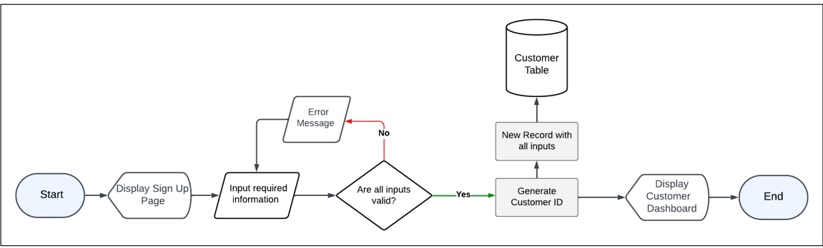
Flowchart is a graphical representation of a program.

Slide 3
Advantages of flow chart in software:
Simplifies Communication
Improves Workflow Design
Facilitates Logical Thinking
Clear Documentation
Saves Time:

Slide 4
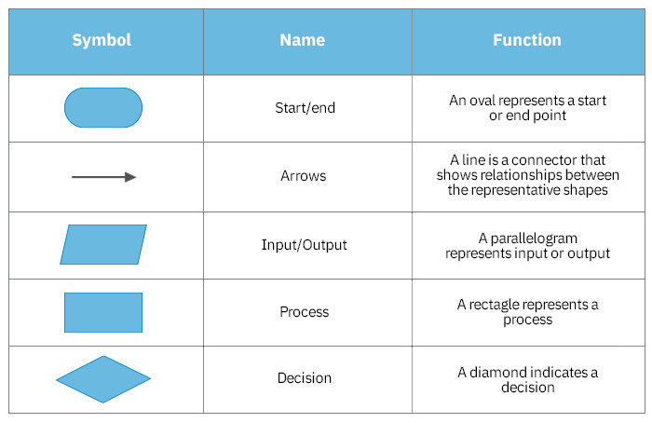

Slide 5
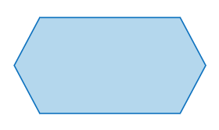
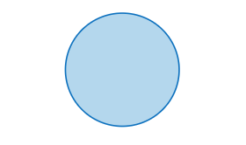
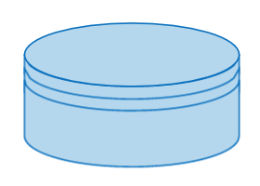

Loop Symbol
Connector Symbol
Subroutine Symbol
Database Symbol

Slide 6
While developing a flowchart :
Flowchart can have only one start and one stop symbol
On-page connectors are referenced using numbers
Off-page connectors are referenced using alphabets
General flow of processes is top to bottom or left to right
Arrows should not cross each other

Slide 7
Find the sum of two Number?
Find the Maximum between two Number?
Display counting Table
Login your account

